Slide 1
FILE IO

Slide 2
Motivation

Slide 3
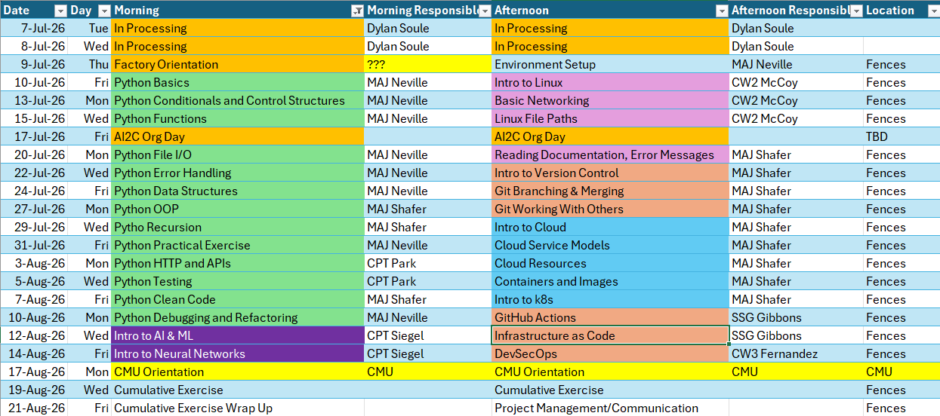
Course Schedule

Slide 4
Review

Slide 5
What is the purpose of user defined functions?

Slide 6
How do you define a function, and how do you use it?

Slide 7
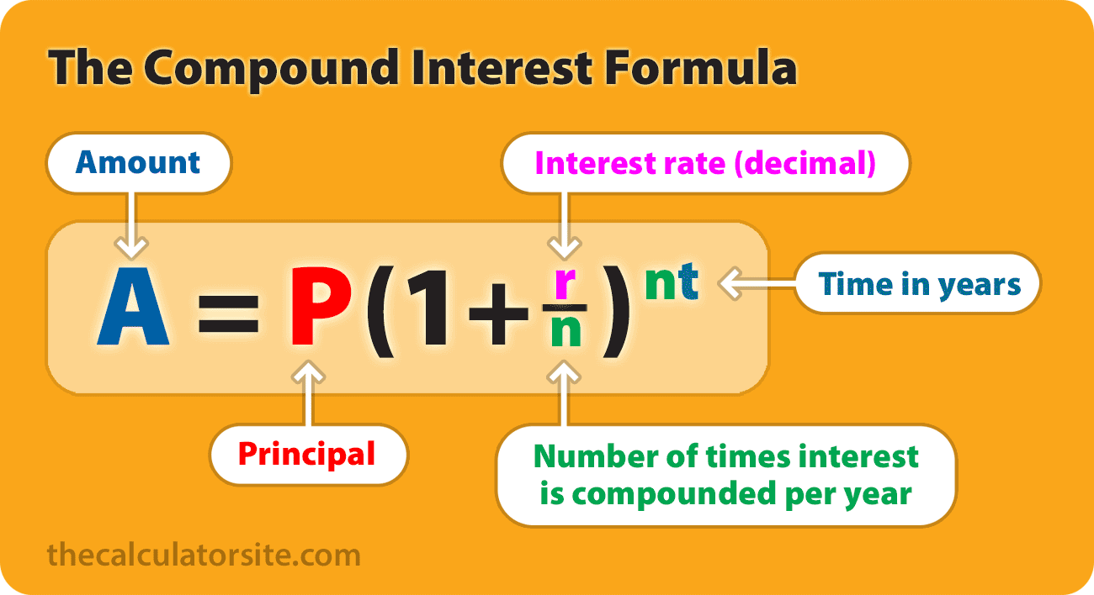
Let’s make this a function:
Desc. | Principal | Rate | # of times compounded annually | Years | Output
Normal Savings Account | 1000 | 0.0061 | 1 | 10 | $1062.70
Money Market Account (Amex) | 1000 | 0.031 | 1 | 10 | $1357.02
Index Fund | 1000 | 0.07 | 1 | 10 | $1967.15

Slide 8
Today’s Lesson Objectives
Utilize the os and pathlib.Path modules to navigate a filesystem
Utilize standard python functions to manipulate files

Slide 9
OS module
The os module in Python provides a way to interact with the operating system. It offers a portable interface for OS-dependent functionality, meaning your code can work across different platforms (Windows, macOS, Linux) without major changes.

Slide 10
OS module
Core purposes:
1. File & Directory Operations
Create, rename, delete files and directories (os.mkdir(), os.remove(), os.rename())
List directory contents (os.listdir())
Check if paths exist (os.path.exists())
2. Path Manipulation (via os.path)
Join paths portably: os.path.join("folder", "file.txt")
Split paths, get extensions, get filenames
Get absolute paths: os.path.abspath()
3. Environment Variables
Read and set environment variables: os.environ.get("HOME")
Useful for configuration and secrets management

Slide 11
OS module
3. Environment Variables
Read and set environment variables: os.environ.get("HOME")
Useful for configuration and secrets management
4. Process Management
Get the current process ID: os.getpid()
Run shell commands: os.system("ls")
Terminate the process: os.exit()
5. System Information
Get the current working directory: os.getcwd()
Change the working directory: os.chdir()
Detect the OS name: os.name (returns 'nt' for Windows, 'posix' for Unix-like)

Slide 12
OS module EXAMPLE
Example:
import os
# Get current directory
print(os.getcwd())
# Build a cross-platform path
path = os.path.join("data", "reports", "summary.csv")
# Check if it exists
if os.path.exists(path):
print("File found!")
# Read an environment variable
api_key = os.environ.get("API_KEY", "default_value")

Slide 13
OS module CHEATSHEET
Python Function | Description
os.getcwd() | Returns the current working directory.
os.chdir(path) | Changes the current working directory.
os.listdir(path='.') | Lists files and directories in the given path.
os.mkdir(path) | Creates a single directory.
os.makedirs(path) | Creates nested directories recursively.
os.remove(path) | Deletes a file.
os.rmdir(path) | Removes a directory (must be empty).
os.rename(src, dst) | Renames or moves a file or directory.
os.stat(path) | Returns info about a file (like size, modified time).

Slide 14
Look familiar?
Python Function | Description | Linux Command Equivalent
os.getcwd() | Get current working directory | pwd
os.chdir(path) | Change current directory | cd path
os.listdir(path='.') | List files and directories | ls
os.mkdir(path) | Create a directory | mkdir path
os.makedirs(path) | Create nested directories | mkdir -p path
os.remove(path) | Delete a file | rm path
os.rmdir(path) | Remove empty directory | rmdir path
os.rename(src, dst) | Rename or move file/directory | mv src dst
os.stat(path) | Get file/directory status | stat path

Slide 15
Pathlib MODULE
An object-oriented* focused path library
The pathlib module (introduced in Python 3.4) provides an object-oriented approach to filesystem paths, treating paths as objects rather than plain strings. It's the modern alternative to os.path.
Core purposes:
1. Path Creation & Representation
Paths are objects, not strings: p = Path("/home/user/file.txt")
Automatically handles / vs \ across platforms
Use / operator to join paths intuitively: Path("folder") / "sub" / "file.txt“
2. File & Directory Operations
Create directories: p.mkdir(parents=True, exist_ok=True)
Delete files/dirs: p.unlink(), p.rmdir()
Rename/move: p.rename("new_name.txt")
Check existence: p.exists(), p.is_file(), p.is_dir()
3. Reading & Writing Files
Built-in read/write without needing open():

Slide 16
Pathlib MODULE CHEATSHEET
An object-oriented* focused path library
from pathlib import Path
Operation | Example Code
Create / Join Path | Path('folder') / 'file.txt'
Check Existence | p.exists(), p.is_file(), p.is_dir()
Read / Write File | p.read_text(), p.write_text('Hello')
Create Directory | p.mkdir(exist_ok=True)
List Contents | for f in Path('.').iterdir(): print(f)
Search Files | Path('logs').glob('*.txt')
Remove File | p.unlink()
Get File Info | p.stat().st_size, p.stat().st_mtime

Slide 17
Hands-On #1
Navigating file structures with python

Slide 18
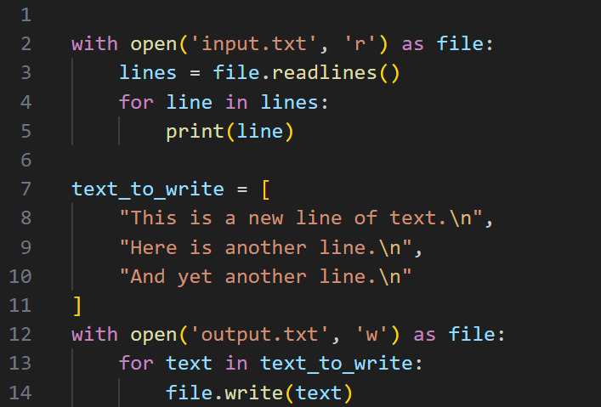
Manipulating files

Slide 19
Common Actions
Operation | Description
with open('file.txt', 'r') as f: pass | Prepare a file for reading
f.read() | Read entire file as a string
f.readlines() | Read file line by line into a list
for line in f: pass | Loop through file line by line
with open('file.txt', 'w') as f: f.write() | Overwrite with new content
with open('file.txt', 'a') as f: pass | Add content to end without erasing existing
f.writelines(lines) | Write a list of strings

Slide 20
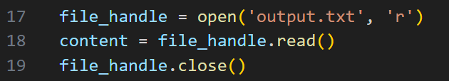
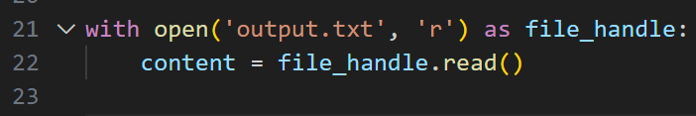
A word about context managers

Slide 21
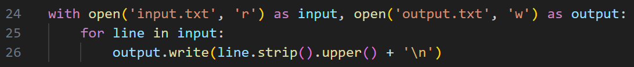
Another word…

Slide 22
Hands-On #2
Manipulate files in python

Slide 23

Questions?

